Slide 1

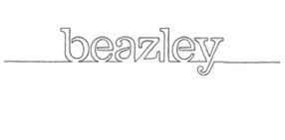
Sprint and Operational Recap
Production: August 05, 2022
Production: August 12, 2022

Slide 2
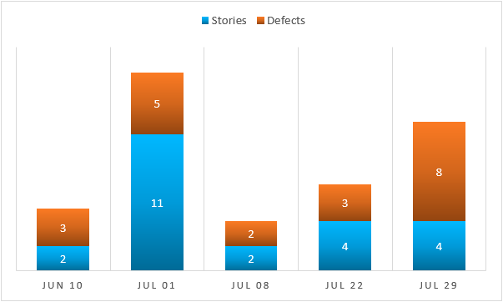
Completed Sprint : July 29th, 2022– Aug 12th, 2022
Objective: BBR updates and defect resolution
Key Functional Deliveries and Highlights
Beazley Breach Response
Sublimit updates
Updates to application document
MediaTech Package
Dynamic sub-limit rating based on answers to RSA questions
Defects
A large number of defects were resolved with this release
Now allowing special characters that were once blocked
Corrected a renewal creation issue
The team was able to balance defect resolution with the delivery of priority stories

Slide 3
Completed Sprint : July 29th, 2022– Aug 12th, 2022
Quality Assurance
Automation
96% automated regression passed including API
Only run 124 automation scripts
96 end to end scenarios
28 API scenarios
Manual Regression
Bug Fixes
Key Deliverable
BBR – API Retail Business industry class is Allowed but was Declined in DRC - No pricings
BBR – API – Industry Class Updates
BMT - Add BMT Endorsement for CA -Music Copyright Claims Exclusion endorsement - E14973 082021 ed.

Slide 4
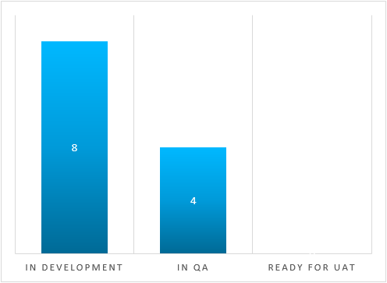
Current Sprint : Beginning August 05, 2022
Objective: API, Endorsements, Defects
Key Functional Deliveries and Highlights
Current Sprint Status
Beazley Breach Response
Adding/updating several endorsements
Industry Class updates for including Surplus rating
Including RSA logic to update sub-limits instead of blocking quotes
MediaTech Package
Update to the NJ Assessment
Defects/Improvements
Invoice generation issue on rollbacks
Industry class naming corrected
We are on track to deliver high priority features along with several defect fixes to UAT on 8/16/22.

